Slide 1
OpenTelemetry using ASP.NET Core 6
Created By – Rahul Ranjan
Employee ID: 2048766

Slide 2

Topics to be covered
What is OpenTelemetry?
Backend or opensource Tools
Code View
The Applications & OTel Architecture
Docker & Kubernetes (K8s)
Templates Used in CCAP

Slide 3
What is OpenTelemetry?
It is an open-source observability framework.
It is a collection of tools, APIs and SDKs.
It is used to instrument, generate, collect and export telemetry data (metrics, logs and traces).
This helps us analyze our software's performance and behavior.
It is used to troubleshoot, debug and manage applications and their host environment.
It exports data to a variety of open-source and commercial backends.

Slide 4
Backend or opensource Tools
OTel collects several classes of telemetry data and exports them to backend tools – Jaeger, Zipkin, ELK Stack, Prometheus, etc.
OTel is used to track or trace requests made to any API.
It provides all the details of the request made.
These tools collect the details and show us these details systematically.

Slide 5

Jaeger
It is a backend tool for OpenTelemetry. It comprises UI, collector, query and agent.
It collects the telemetry data sent by the API and shows the data in the UI.
The developers are then able to access the data conveniently.
It can be downloaded from the website or can be containerized using Docker.

Slide 6
Zipkin
It is a distributed tracing system.
It helps gather timing data needed to troubleshoot latency problems in service architectures.
It collects telemetry data and shows the results in a systematic way to the developers.
The developers are then able to trace the requests made to the API.

Slide 7
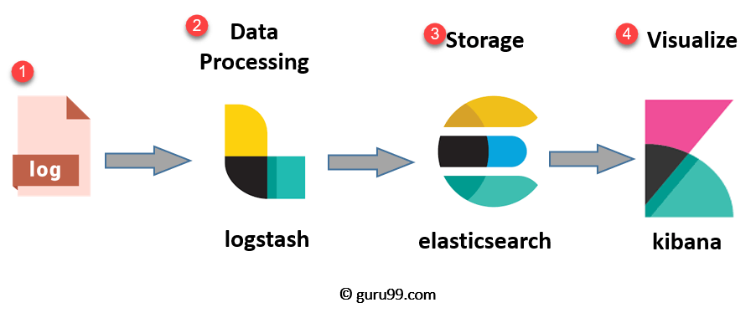
ELK Stack
ELK stands for Elasticsearch, Logstash and Kibana.
Elasticsearch uses Logstash for its functioning and Kibana uses Elasticsearch for getting the data.
The ELK stack collects data from the API and Kibana shows the data in GUI format to the developers.
The users are then able to trace the requests made to their API conveniently.

Slide 8

Prometheus
It is also a backend tool for collecting telemetry data.
It is a simple way to store time series metrics.
It provides users with the tools they need to collect, store, check and query metrics.
Metrics(numeric measurements) are recorded over time. As a result, the developers are able visualize the collected data.

Slide 9
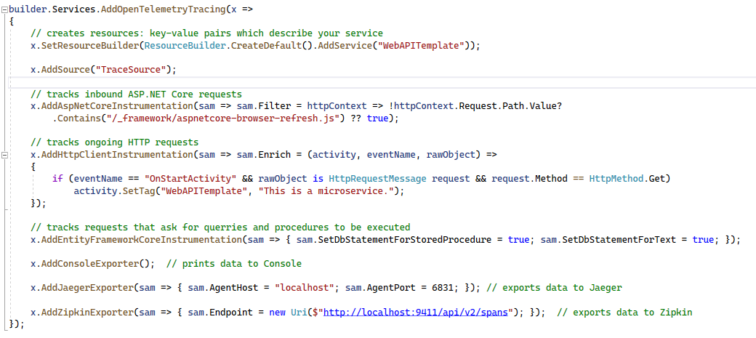
Code View: Adding OTel to WebAPI

Slide 10
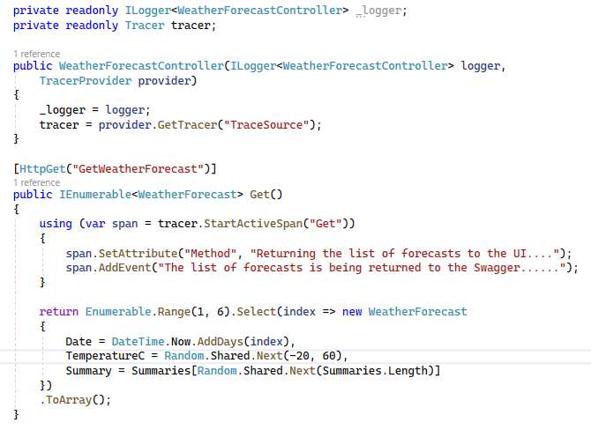
Code View: Adding our own Logs

Slide 11

The Solution
First, we need to run the images of Jaeger, Zipkin, Elasticsearch, Logstash and Kibana as containers in Docker or in Kubernetes (K8s).
Then, we need to check their respective localhost URLs in our browser.
Using their URLs, we needed to send our data to them.
We need to collect ASP.NET (internal) request and response data as well as the HTTP (external) request and response data.

Slide 12
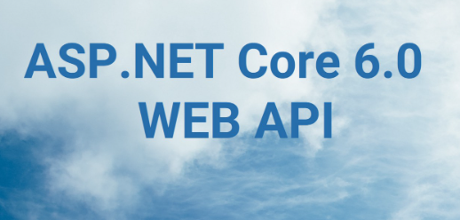

The Applications & OTel Architecture
Jaeger
App 1
Zipkin
OTel
Protocol
OTel
Collector
Prometheus
Worker Services
In
ASP.NET
Core 6
App 2
Receive, Process,
Analyze &
Export data
Azure Monitor
Elastic APM
ELK & Others

Slide 13
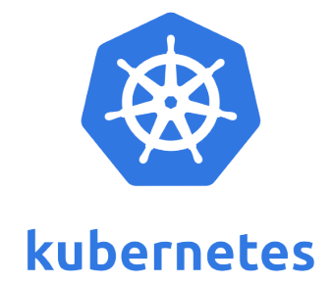
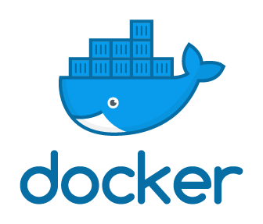
Docker & Kubernetes
Docker Desktop is a tool where we can download several images and run them as containers. It can even be used to run operating systems.
Docker Desktop provides facilities for Docker and for Kubernetes (K8s).
We can run backend tools using docker or Kubernetes and send our data to them from our APIs.
It also provides facility to deploy our APIs as local containers. This can again be deployed to Azure cloud as freely running web container.
Code Demo

Slide 14
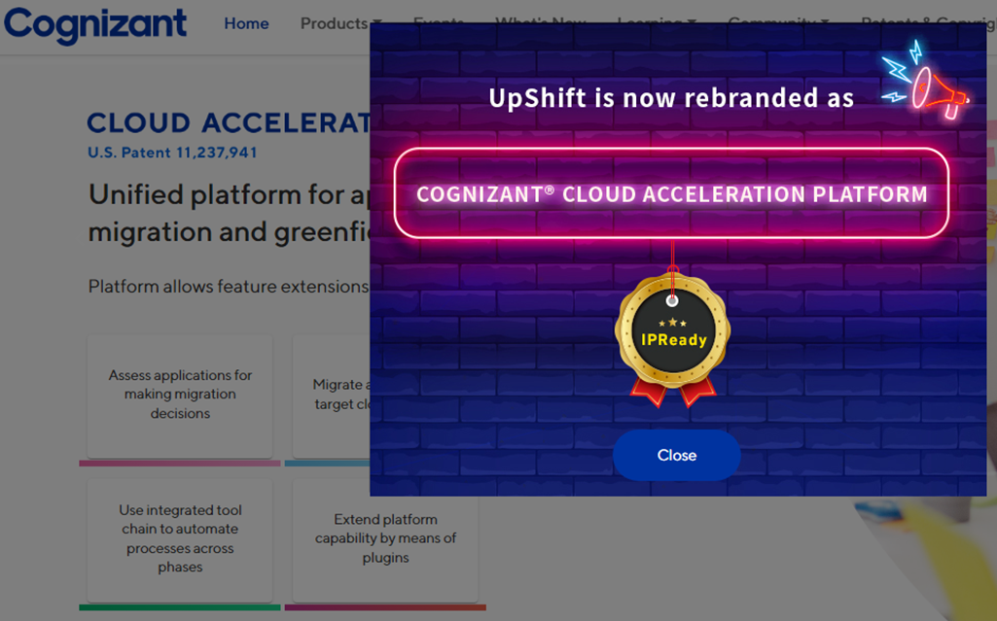
Templates Used in CCAP
ASP.NET Core 6 WebAPIs that were integrated with OpenTelemetry are currently in use in CCAP.
ASP.NET Core 6 Worker Services that were integrated with OpenTelemetry will be added to CCAP soon.
It is a platform which provides various services.
It also provides various ASP.NET Core 6 templates with automatic integrations with various technologies.

Slide 15


